Slide 1













NOAA’s Model Diagnostics Task Force Framework
Aparna Radhakrishnan
On behalf of the
MDTF framework team
WCRP Open Science Conference 2023, Rwanda
Session: LL04 - CMIP and CORDEX Analysis and Evaluation Tools

Slide 2
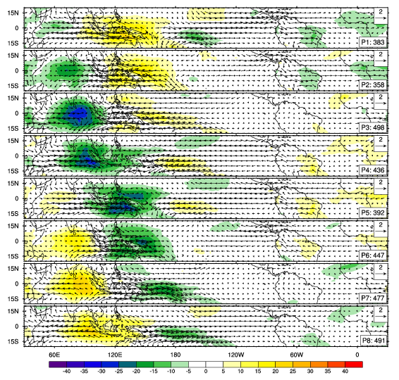
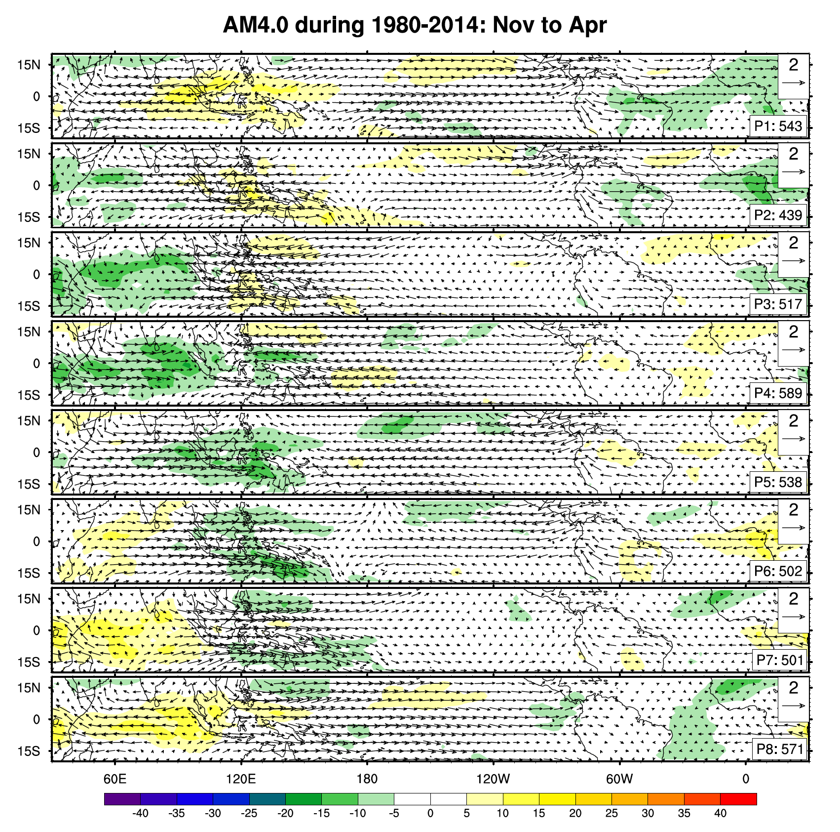
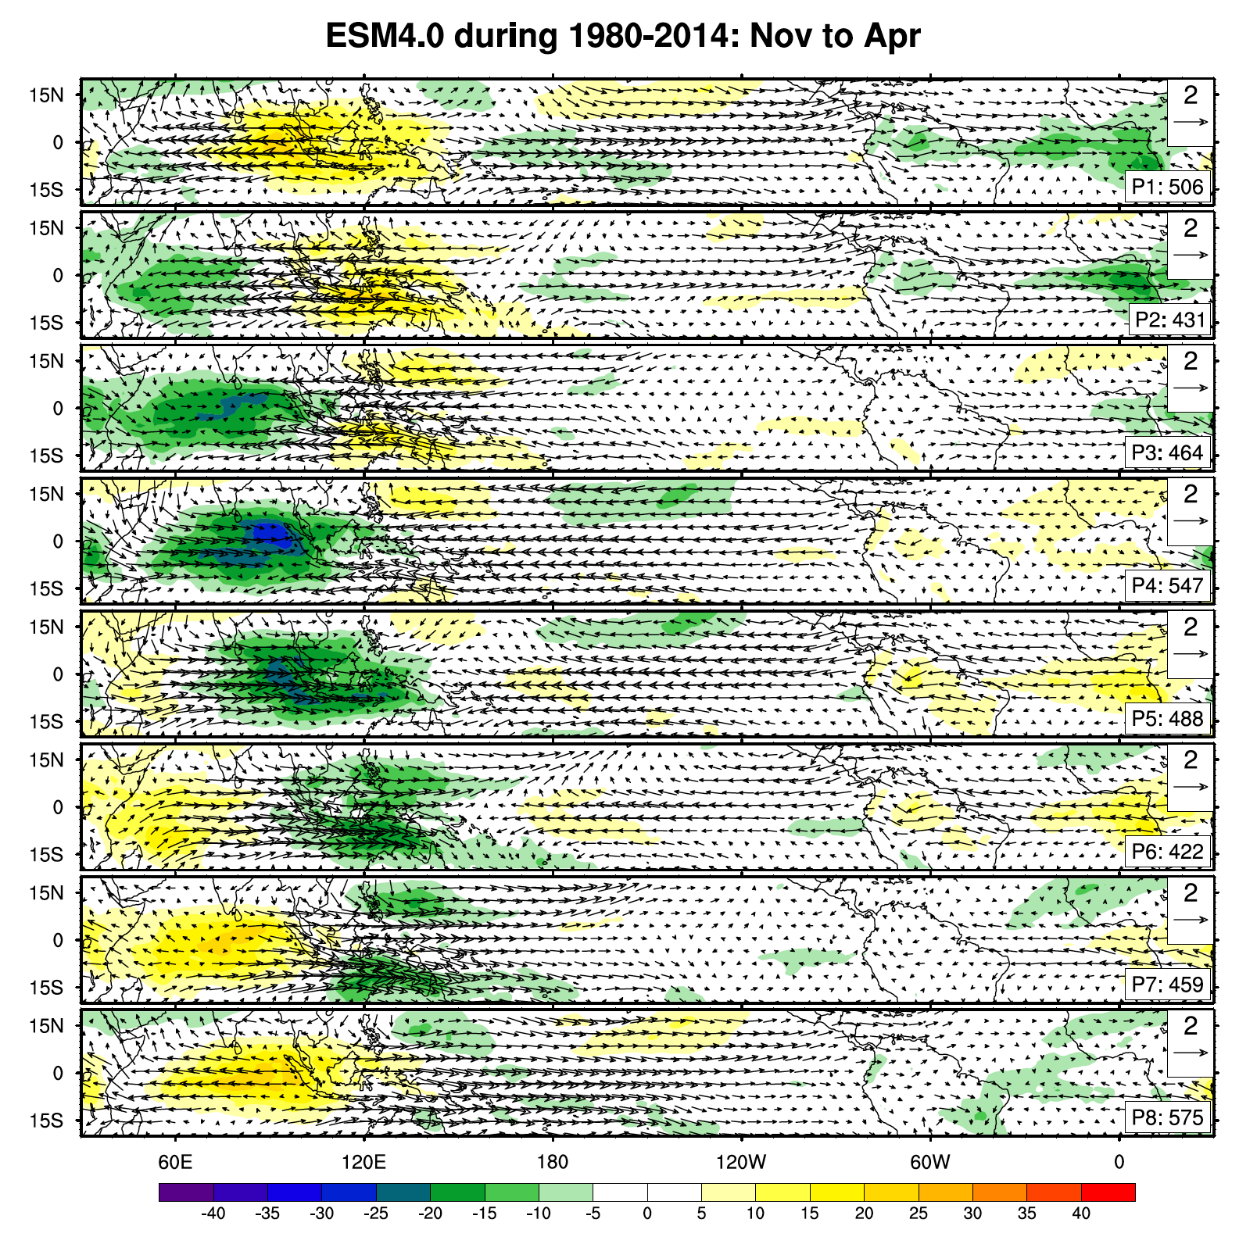
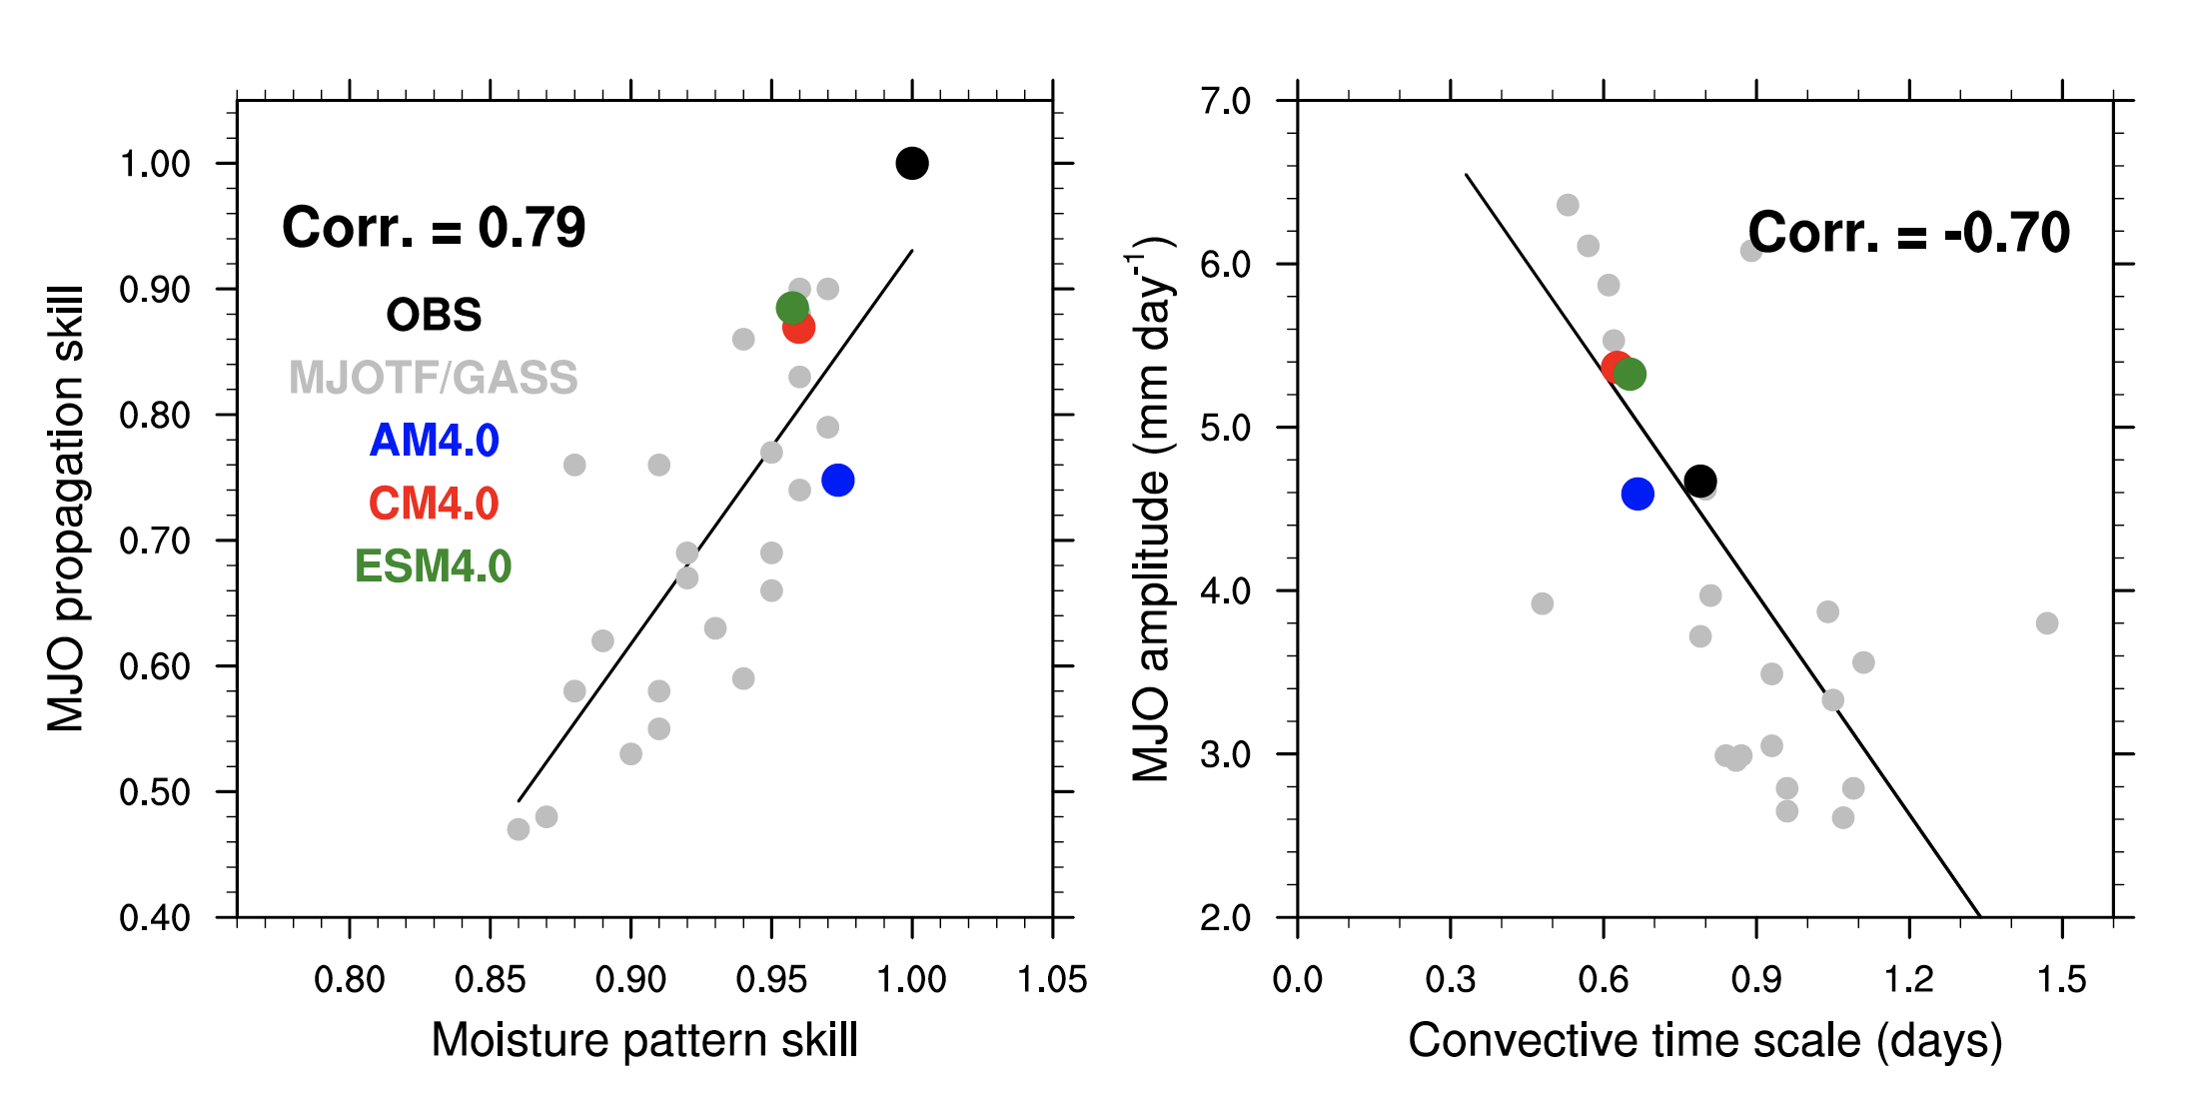
Process Oriented Diagnostics (POD)
Gonzalez, A. O., and X. Jiang (2017)https://doi.org/10.1002/2016GL072430.
OBS
GFDL-AM4
GFDL-ESM4
Ref. Dong, 2021, UFS webinar, CMIP6 datasets from ESGF.
MJO lifecycle
Maritime continent moisture pattern skill is correlated with MJO propagation skill; Convective timescale is correlated with MJO amplitude.
Why does the model behave a certain way?
Deep-dive into the processes, emergent behaviors..
Learn, share, improve

Slide 3


NOAA’s Model Diagnostics Task Force, funded by NOAA MAPP
Task Force Lead: D. Neelin (UCLA)
What We Have Done:
Established community of >90 diagnosticians
Built a Python-based framework
Collaboration with DOE on Earth System Metrics and Diagnostics Standards
Prepared extensive documentation & tutorials
Moved to an open-development environment
Ability to do multi-model comparisons
Robust Testing
Where We are Going:
Major “data processor” redesign for an agile framework for ALL.
Expand to more Earth system components
Explore more weather-scale phenomena
Model workflow integration
Align with GFDL/NOAA objectives while collaborating with other community partners
Connect model development efforts with expertise in the academic and private sectors to evaluate and improve model performance and process representation
A.Radhakrishnan, MDTF, WCRP OSC 2023

Slide 4
Learn more about MDTF!
MDTF GitHub Repository: https://github.com/NOAA-GFDL/MDTF-diagnostics
MDTF YouTube Tutorials:
Installing the MDTF-diagnostics package
Contributing a POD to MDTF-diagnostics repository
Recent publication:
Neelin, J. D., and Coauthors, 2023: Process-Oriented Diagnostics: Principles, Practice, Community Development, and Common Standards. Bull. Amer. Meteor. Soc., 104, E1452–E1468, https://doi.org/10.1175/BAMS-D-21-0268.1.
A.Radhakrishnan, MDTF, WCRP OSC 2023

